Slide 1
Trần Công Duy Nguyên – EDA34

Slide 2


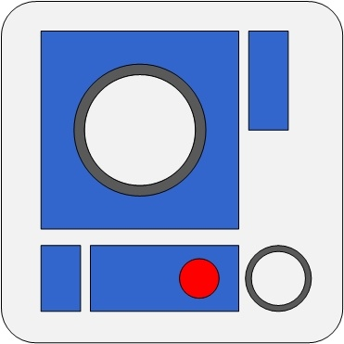

Currenty working on R2-T2 tool
Requirement Test Report Tool
Notes:
Take full responsibility for developing its be and fe.
Use expressjs for be and a framework called Quasar to develop fe
- And yeh, this Quasar fw is built on VueJS – the topic of my sharing today

Slide 3

Vue introduction
The progressive framework

Slide 4
Agenda
What is Single Page Application (SPA)?
What is Vue?
The Vue instance
The component system
The rest of Vue ecosystem
Live code
Opinionated comparison
Notes:
Give you a look about SPA bc it’ll help you understand the mission of VueJS
Then we start digging deeper to the fw with …
Next, give you a more practical view of how everything basically works
The last will be the most interesting part -> the comparison between Vue,React, Angular. Stay tuned!

Slide 5
What is Single Page Application?
The revolution of SPA
Notes:
So, how the SPA has evolved

Slide 6




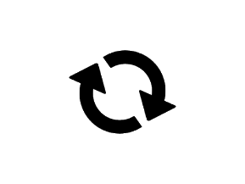



The ‘old’ way
Client side
Multiple Page Application
Request
Response
Server side
Presentational Layer
Controller
Views
Big payload
Browser refreshing
Duplicated content
Coupling
Service Layer
Business Layer
Jarring, bad UX
Slowdown the development
Heavy transactions
Bad practice
Data Layer
Data
Source
Notes:
This pic shows you how a traditional website work, we have a backend app which returns HTML page whenever client sends request
The server will handle the client request and generate HTML page within Presentational Layer
With this architecture, we’ll have some drawback such as…

Slide 7


The revolution of AJAX (Asynchronous JavaScript and XML)
XMLHttpRequest (XHR) API
Update
+
Notes:
With browser started supporting XHR API and the power of JS => the UI on the browser can be updated partially and asynchronously
This technique called AJAX and it will move the responsibility of processing UI from server side to client side

Slide 8

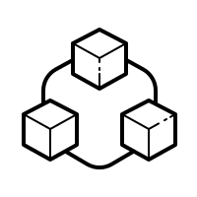


The ‘SPA’ way
Client side
Views
Single Page Application
AJAX
Presentation logic
Single HTML initialize only once
Dynamically & asynchronously updating DOM
Presentation logic
is handled at frontend
Server side
Communicating via
JSON data
JSON, XML…
Controller
JSON, XML…
Service Layer
Business Layer
Increase
codebase reusability
Decouple development process
Lighter payload for later transactions
Without Browser refreshing
Data Layer
Data
Source
Notes:
And this is the model of a SPA, in the first request the client side will receive all the script it need to have to implement the render process
After that, any followed request will dedicate to receive the data or the state of the UI and let the client do the rest of the work
This architecture will give us many benefits…

Slide 9







SPA is very popular
Give better UX for end users
Beneficial to PWA and mobile development
Easier for developers
Notes:
The SPA technique has been broadly using in the world, many big applications have successfully implemented it like…
And the advantage is really obvious…
And yes, that’s how great the SPA is. Next step, we will see how Vue makes a SPA

Slide 10
What is Vue?
Brief history
Design philosophy
Preparation
Notes:
We will have 4 main part in this section

Slide 11



Brief history
Evan You
Vue in French
=
View in English
First commit was on July 2013
Notes:
So this guy is Evan You, the father of Vue. He is an ex-google developer and worked at Google Creative Labs
Vue is French word and it means view in English
Vue was inspired by Angular JS which also called Angular 1
And his first commit of this project was on July 2013

Slide 12
Design philosophy
Build
System
Declarative
Rendering
Component
System
Client-side
Routing
State
Management
Notes:
The design philosophy basically means the idea of the framework
Regarding that, the Vue idea is progressiveness. Let’s me explain you what it means:
when developing web you can go from a small, simple app with just some simple widget to a complicated app like commercial or enterprise app; and Vue will provide you the proper tool for each stage.
For ex, if you just build a simple page without navigation or you just embedded a part of your UI with Vue, you just need a vue-core library which supporting declarative rendering…

Slide 13

The declarative rendering
State
Rendered UI
Vue core
Declarative
How the state should be on the UI
Imperative
What are the step to transform the state to the UI
data: { text: ‘Hello World’ }
<div id=‘demo’> {{text}} </div>
const newElement = document.getElementById(‘demo’)
newElement.textContent = ‘Hello World’
Notes:
Next, we will explore the first layer of the fw
So what is declarative rendering? Let’s see the picture, Vue core acts as a machine which will process the state to generate the UI for us.
In other word, we will define how Vue will generate the UI from the state or the data
It’s really different from the imperative style which we tell our code what steps to create the UI
You can find the imperative in the famous fw call Jquery, or when you make web frontend without any fw

Slide 14
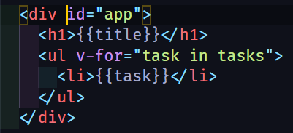
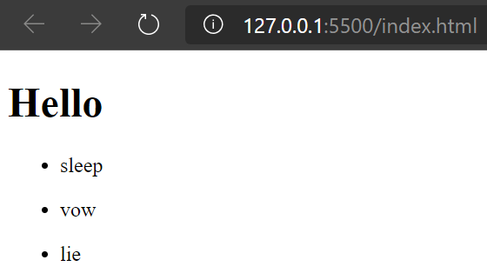
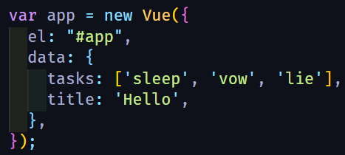
Interpolate template
Hook up
Vue instance
Notes:
We can look at the ex: We define the Vue instance then hook it to our markup.
Vue will help us do the rest of work by rendering the markup. Right here, it uses Interpolate template to interpret JS to string
Ok, it’s the first and basic layer of Vue

Slide 15
Preparation
Content Delivery Network (CDN):
<script src="https://cdn.jsdelivr.net/npm/vue/dist/vue.js"></script> (development)
<script src="https://cdn.jsdelivr.net/npm/vue"></script> (production)
vue-cli:
vue create <project name> or vue ui
Vscode extension: Vetur
Vue core
Browser extension: Vue.js devtools
Notes:
Now let see what you’ll need to implement the vue-core..
- The quickest: CDN
Experience SFC
Improve syntax highlight
That’s it, now you can create an Vue app :D

Slide 16
The Vue instance
Architect pattern
Vue options
Vue directives
Instance lifecycle
Notes:
Ok, now we’re going to see the heart of Vue – the vue instance
Why I call that a heart of vue, because we need Vue instance to bind the UI and our presentation logic

Slide 17
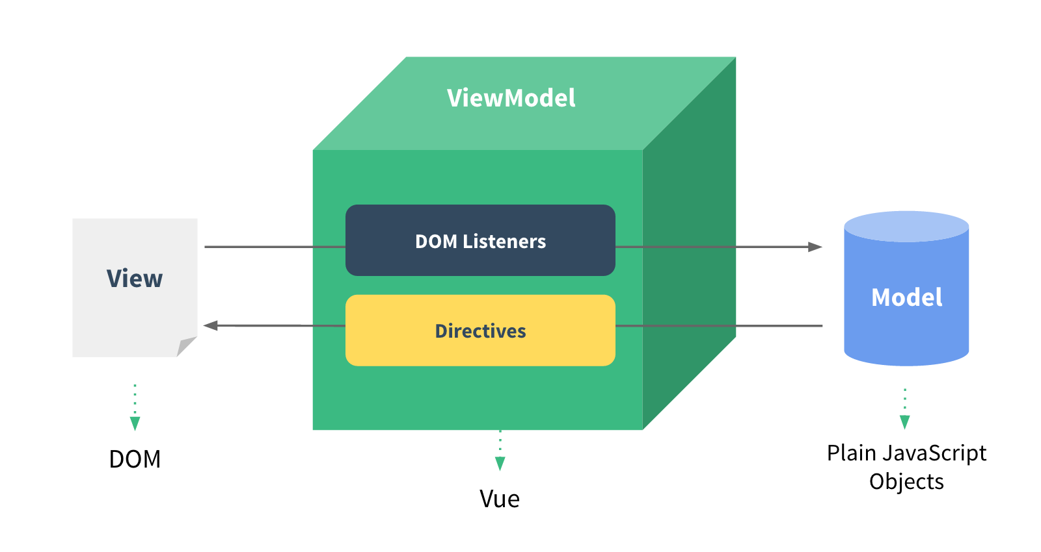
Architecture pattern
Notes:
First, we will look through the architecture pattern, which concrete and inspire Vue
This architecture partly alike MVVM pattern.
While the vue instance play a ViewModel role, our DOM and our Data act as View and Model respectively
And with this pattern, Vue instance will help us to build up our UI base on the data or the state from our backend

Slide 18
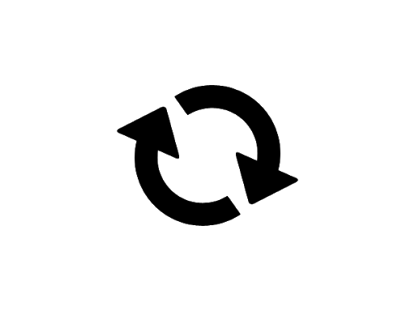
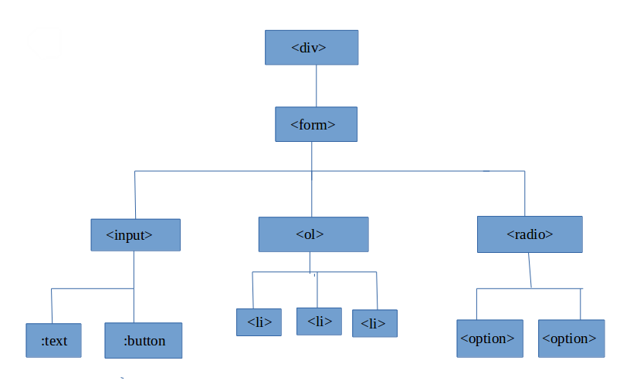
The vue instance
Life cycle
beforeCreate
beforeUpdate
HTML Tree
created
updated
beforeMount
beforeDestroy
mounted
destroyed
Vue instance
Vue directives
{Options}
#el
computed
template
data
methods
Notes:
So this is how the Vue instance really look like, it comprises of 3 main part:
The options: define the behavior
Vue directives: Help vue instance interacs with the DOM or the UI
The last is the life cycle functions

Slide 19
Vue options
Notes:
Firstly, the Vue options

Slide 20
#el, template, data
HTML
#el: Mount Vue instance with DOM element
via CSS selector
template: Define HTML markup for Vue instance
within a string
data: A data object or a function return object for Vue component, it’s reactive
Notes:
Vue options programmatically are the properties of the object which we pass into the Vue instance constructor
These options will define the behavior of Vue instance, let’s look through some…
With these three, we can define how the vue instance render the UI

Slide 21
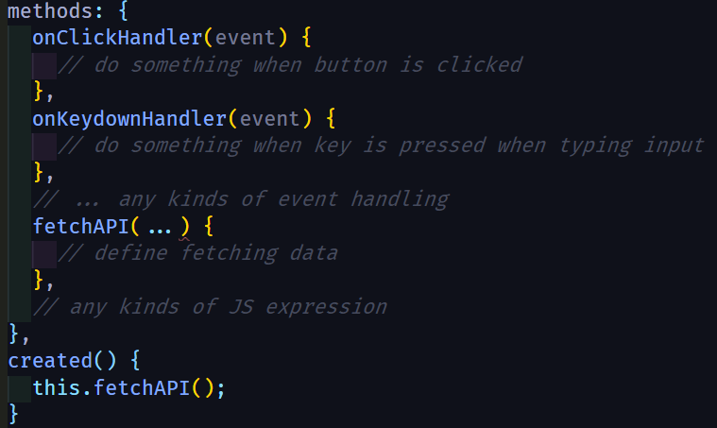
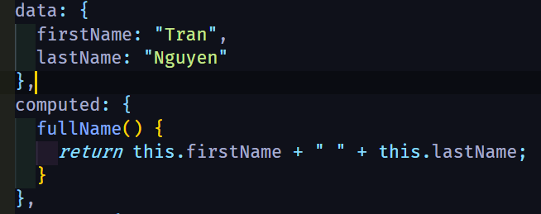
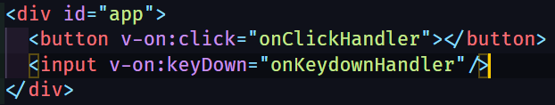
Method, computed
views
data
?
computed
events
methods
Notes:
There’re also 2 more options I want to introduce, that is: method and computed
Now we know how to define the UI state via the data option. Beside that, vue has methods option which let you define the function or the handler for the state inside vue instance
Computed is likely the getter in JS object, it will accumulate the data and return the result
So how does these options really bind with the UI?

Slide 22
Vue directives
Notes:
It relates on the Vue directives.

Slide 23
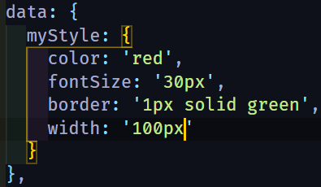



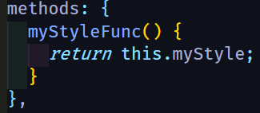
Data binding
data
Template element’s attributes
props
computed
methods
v-bind
…
bind
bind
Notes:
Vue directives are the special tokens provided by vue to do something to the DOM element
It will bind the data to the DOM attribute

Slide 24



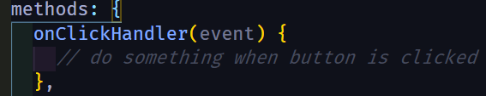
Event handling
v-on
methods
bind
Notes:
Next, we have event handling directive
When user interacts with the UI; the DOM will fire some event; and v-on will help Vue listen to these events

Slide 25
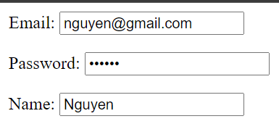
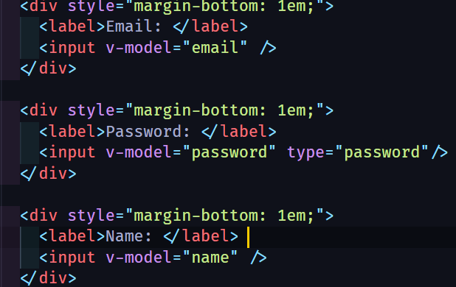
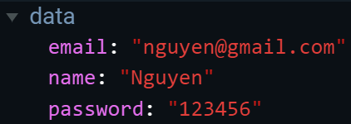
2-way binding
v-on:input
Input value
v-model
v-model
v-bind:value
Notes:
Vue also has 2-way binding mechanism which supported by v-model
2-way binding just means that when the data updated it will change the UI and vice versa when the UI element change it will propagate back to the bind data
This is really useful when using with input element or any stateful DOM element…

Slide 26
Notes
v-on, v-bind shortcut
v-on:click
@click
v-bind:style
:style
specifier
<directiveName>:<argument>.<specifier> = "<expression>"
Ex:
v-on:click.keyup
v-model.lazy
Specifier indicates the directive should be bound in special way
Notes:
This is some additional note when working with vue directives
We have shortcut of v-on and v-bind, both of them has been used too frequently so that Vue decide to give them their shortcut
When apply the directive we also can define its specifier, which indicates…

Slide 27
Conditional rendering
v-if = “conditional expression”
v-else-if = “conditional expression”
v-else
v-show = “conditional expression”
Toggle CSS property display
Toggle real rendering process
Notes:
- It’s time to jump to some structuring directive, which help you construct the UI structure with your logic
- First is the conditional rendering which will apply your condition expression to render the UI
Just like other directive, you declare it as an attribute of DOM element and whenever the condition is matched it will render the element
So there’re 2 type of this directive, the left syntax will… and the right syntax will…

Slide 28
List rendering
v-for = “(value, key, index) in object”
v-for = “(item, index) in array”
<ul v-for = “(item, index) in array” :key=“item.uniqueId”>
// below block of code will have access to item, index
<li>
…
</li>
</ul>
Notes:
- Second, we will have the directive that helps us rendering list.
- For ex, if we want to render items of an array or fields of an object on the UI, this v-for will help us do that on the fly.
When using this structure we should notice the key attribute, this attribute will help Vue identify the element when rendering UI
- That’s the basic directives, now we will move to the lifecycle hooks of Vue instance

Slide 29
Instance lifecycle
Notes:
Essentially, we usually do something before the UI mounted to the browser… or before the UI get destroyed…
Vue provide us many function to interact with the Vue instance lifecycle

Slide 30
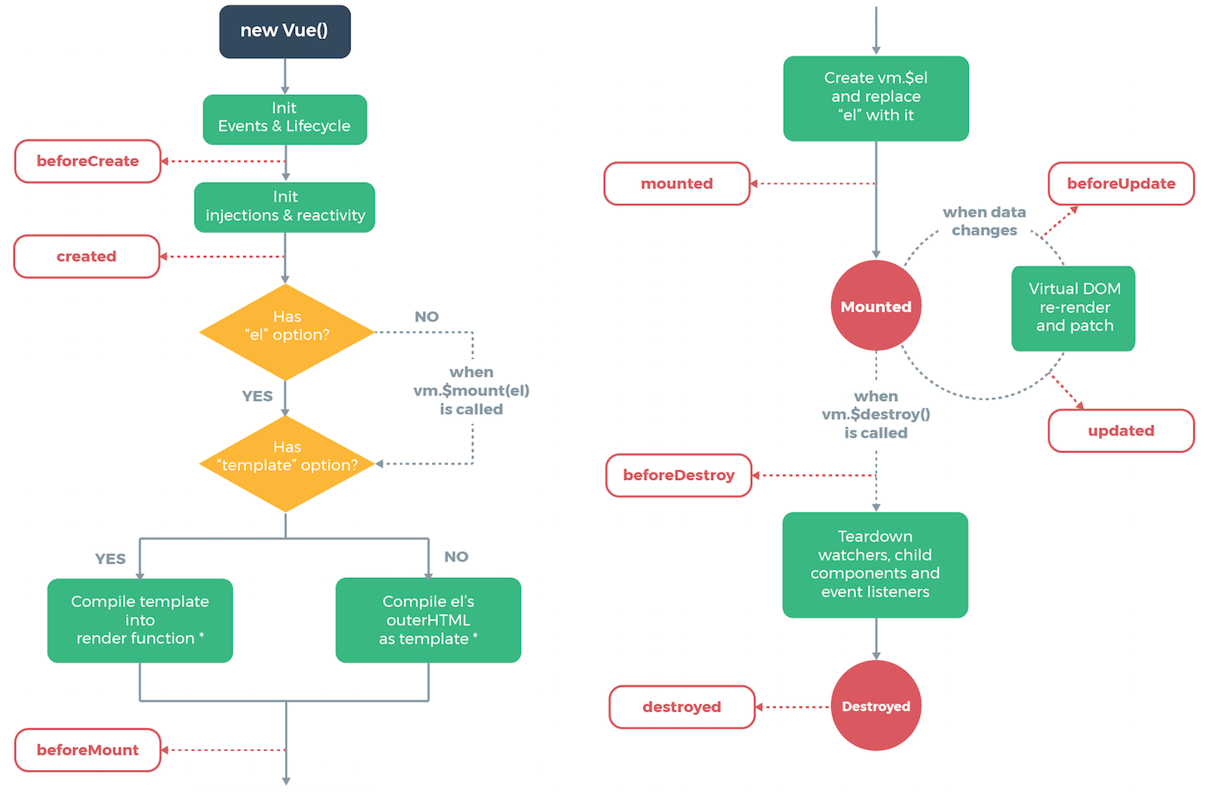
Notes:
And it looks like this, this diagram is available on Vue document and it’s a perfect reference for developer when using those lifecycle hooks
That’s it about Vue instance, now we’re getting to know how to build and compose these vue instances to an app

Slide 31
Vue component system
Vue component
Component communication
Single File Component
Notes:
- The vue component system, it’s also the second layer of Vue framework
- With the knowledge from this layer, you will know how to build Vue app in the component-base way

Slide 32
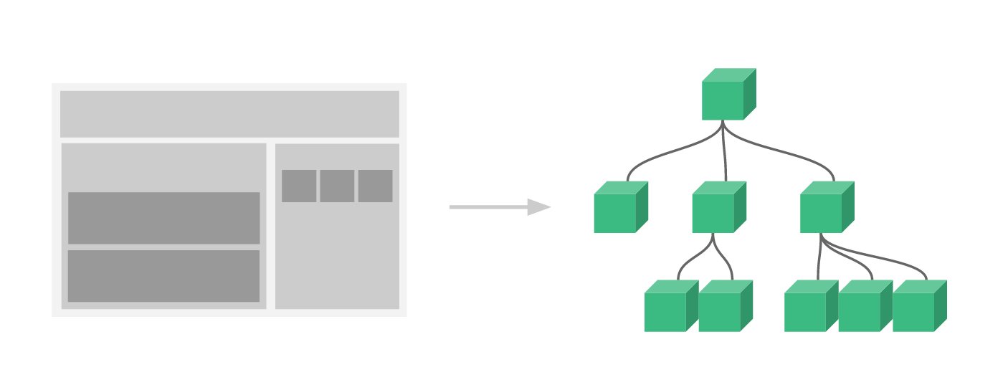
App root
App root
Header
Body
C
D
E
A
Header
Body
Drawer
Drawer
B
A
B
C
D
E
Notes:
When building an UI application, the most effective way is that you should separated the UI to multiple component for easily manage and implement
And usually you will get the tree structure like this when you try to separate the UI on the left, especially in the SPA we usually get the root node and the rest of the interface as its children
These child components are Vue components

Slide 33
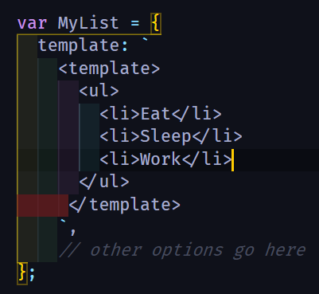

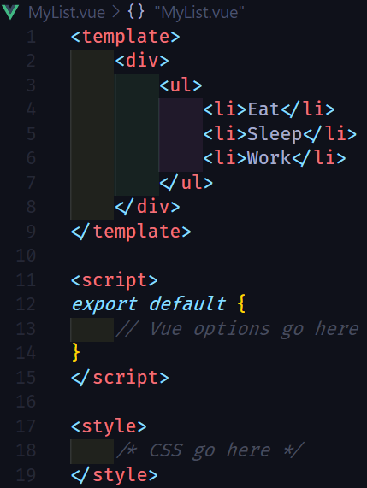


Component creation
Component registration
Literal Template
Local
Global
Single File Component
Usage
Notes:
It basically has 2 step to create a Vue component
First you need to create a component, there’re 2 main type of component in Vue, it’s… and…
Second you will need to register the component, it’s also 2 way to register a component. It’s … and …
Finally, we just need to declare it in our markup

Slide 34
Components communication
Parent
Emit
Events
Pass Props
Child
Notes:
Now we know how to make a component in Vue, let see how we make these component talk with each other.
Do you remember the tree structure of the components? This usually a parent&child relationship between them. So we have this kind of communication: parent can pass data to child and child can propagate its state

Slide 35
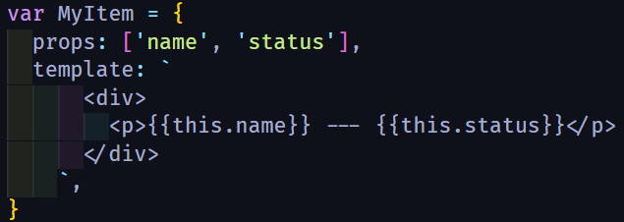
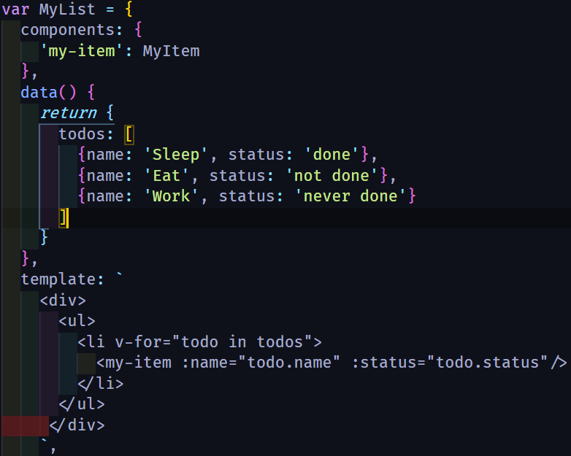
1. Define props inside child component
2. Pass data from parent to child
Parent
Pass Props
Child
Notes:
First, we will see how the parent can pass their state to the child. There’re 2 step:
…

Slide 36

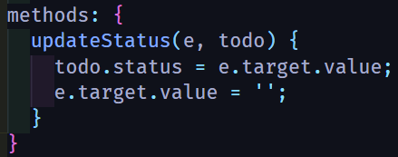
1. Define child component event
Parent
Child event name
2. Listen to child event
Emit
Events
Child
Notes:
Next, we will see how the child propagate its state to the parent. There’s also 2 step:
…

Slide 37
Notes:
With those example code, we will have this UI.
This is the list of child component which make from the line of text and the input
When the child component will render the data from its parent list and propagate the change back via the input

Slide 38
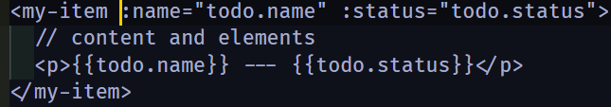
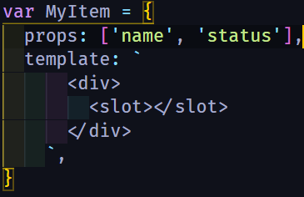
Slot element
How to pass content inside component tags ?
Slots can be separated by slot name
Parent can access child’s data via slot-scoped
Create generic component
Reduce the use of props
Notes:
- Next, we will move to a handful Vue element. The slot element
Are you wonder how we can pass the markup content from the parent to children? This slot element will help you do that
It even has more than just that functionality, but we won’t talk about this now

Slide 39
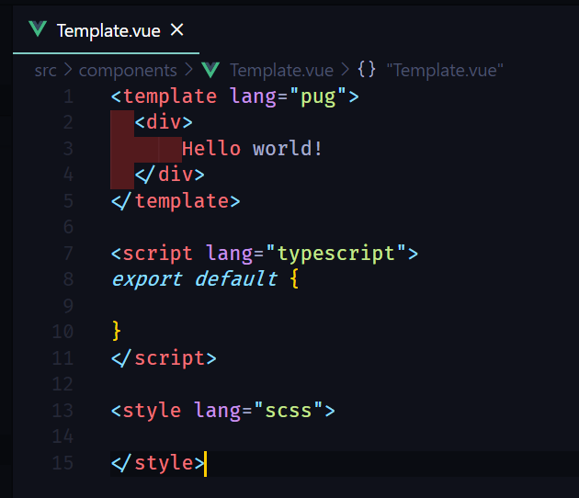

Single File Component (SFC)
Better syntax highlight
CommonJS modules
Codebase is more modularized
Component-scoped CSS
Project configuration is supported by Vue-CLI
Corporated with build system
Notes:
- The last of this section will be the introduction about Single File Component
This is the special modern file which introduced by Vue, it will help us combine our HTML, JS and CSS into one single file in the most flexible way
We usually use this modern tool to create our Vue app, it’s really useful at all
So we’ve gone through 2 layer of Vue, and next I will talk really quick about the rest of the Vue ecosystem

Slide 40
The rest of Vue ecosystem
Vue router
Vuex
Build system: Vue CLI + vue-loader
Rendering process
Notes:
- This is some main point I will go through

Slide 41
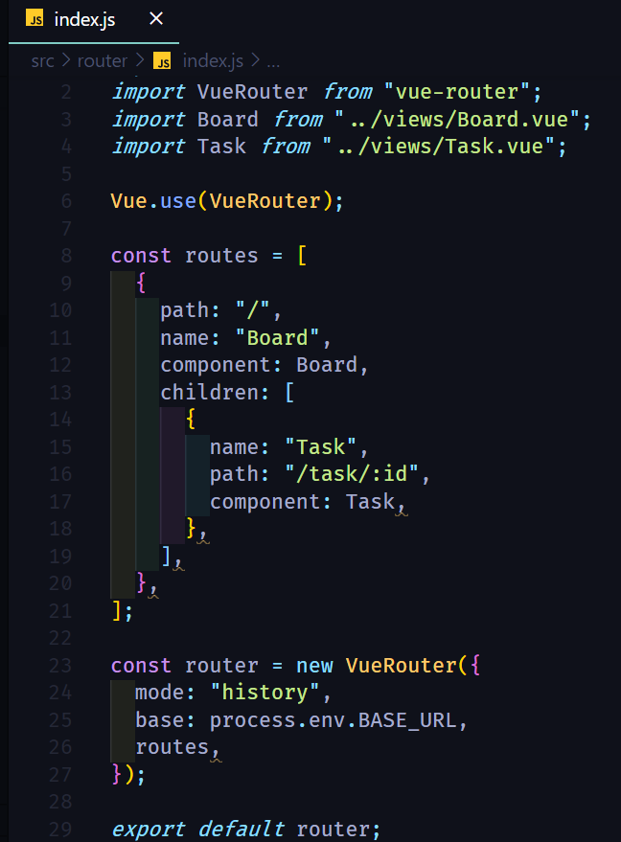
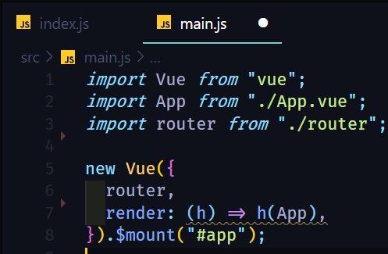
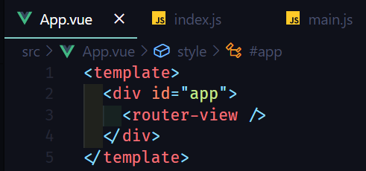
Vue router
Notes:
So just like another modern fw, vue also has it own way to implement the client-side routing system.
I leave the configuration code here for you to reference to

Slide 42
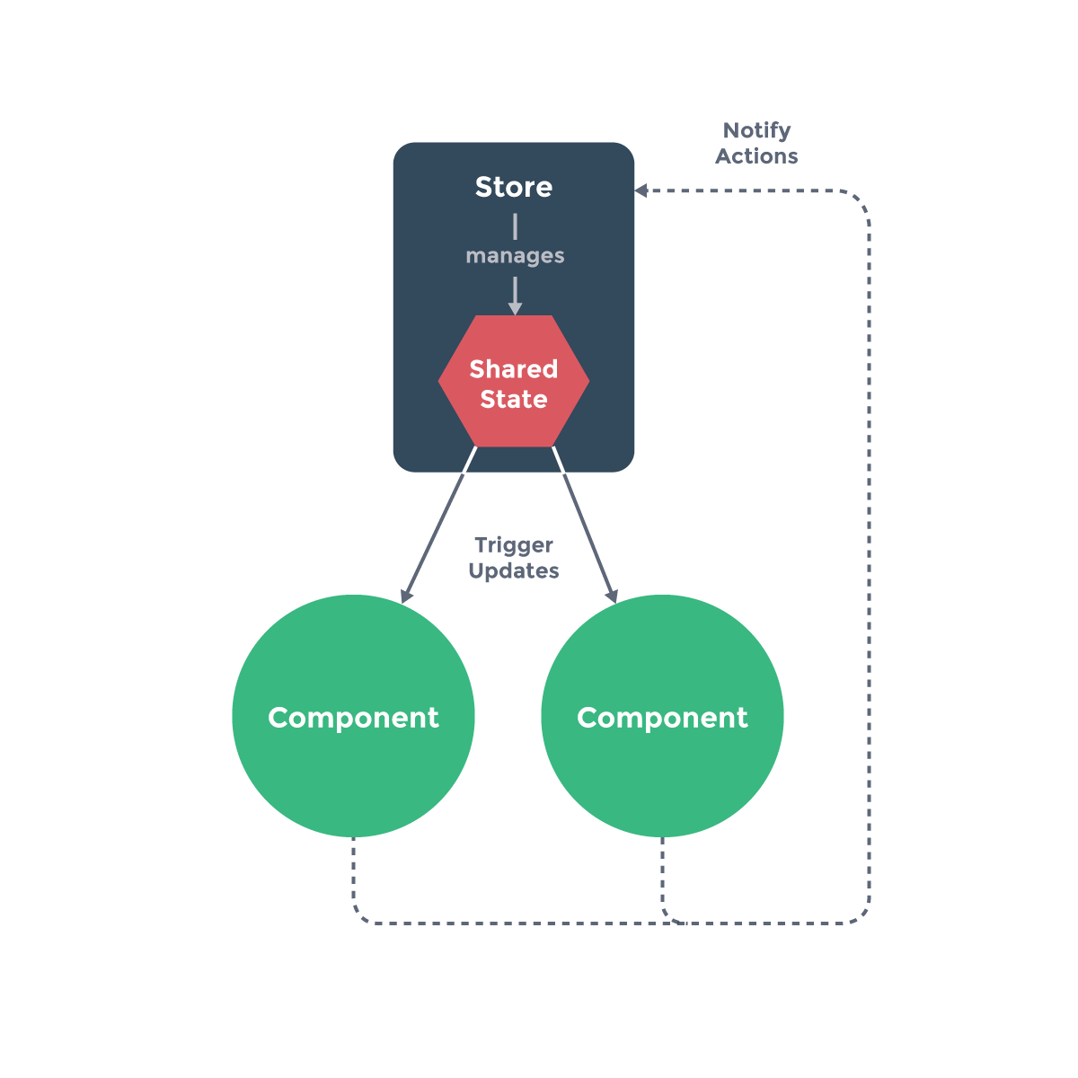
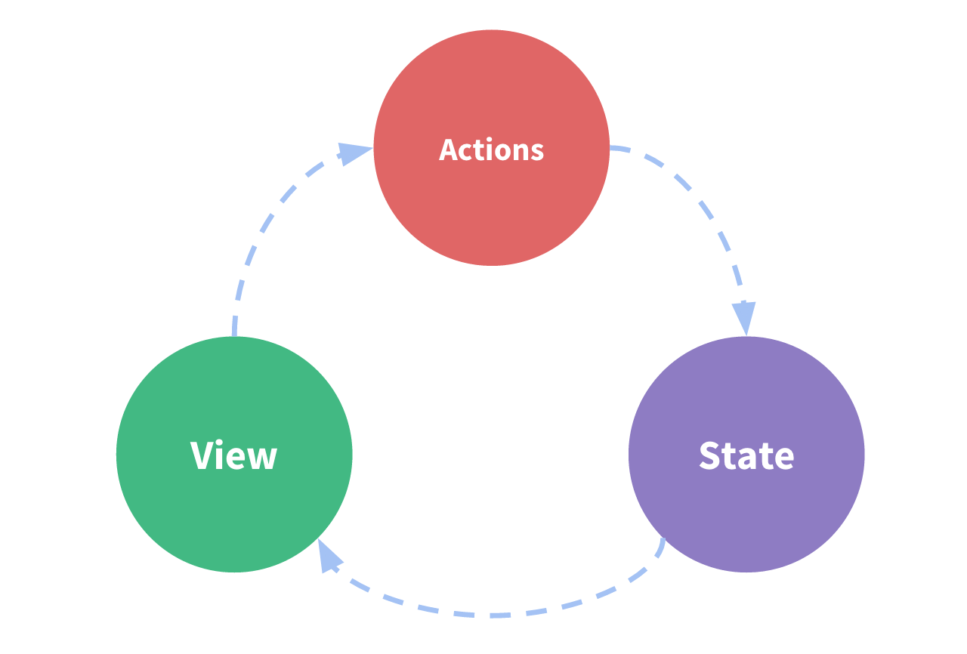
Vuex
Notes:
About state management, Vue has it’s own official library to support developer. It’s called Vuex
When developing frontend, you basically interact with these 3 part:
The view: which the web’s user see
The state: the view will change or render bases on the state
The action: is how to change the state
So vuex will help us manage those part in the most sufficient way, especially when our app grows bigger

Slide 43
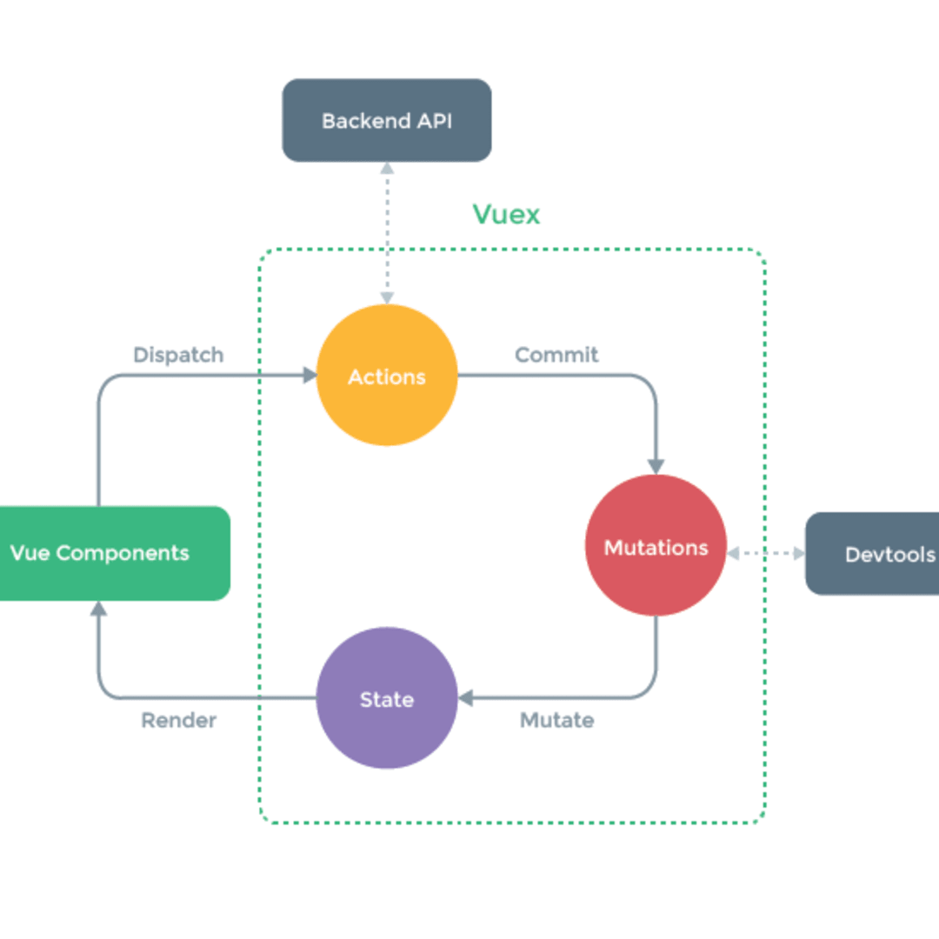
Vuex
Notes:
The mechanism behind the vuex is inspired by Flux so it has the same pattern as Redux if you’ve worked with ReactJS.
Bascically, you will dispatch the action to the store to demand it changes the state via the mutation

Slide 44
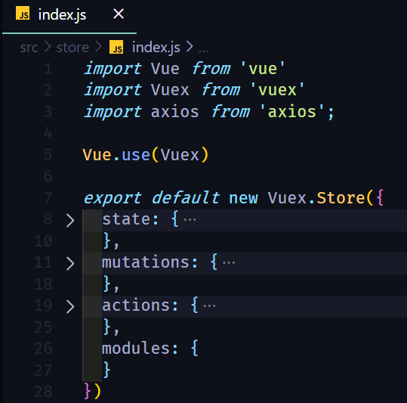
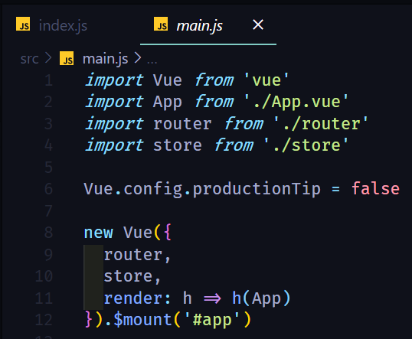
Vuex
Notes:
- This is how you config vuex

Slide 45
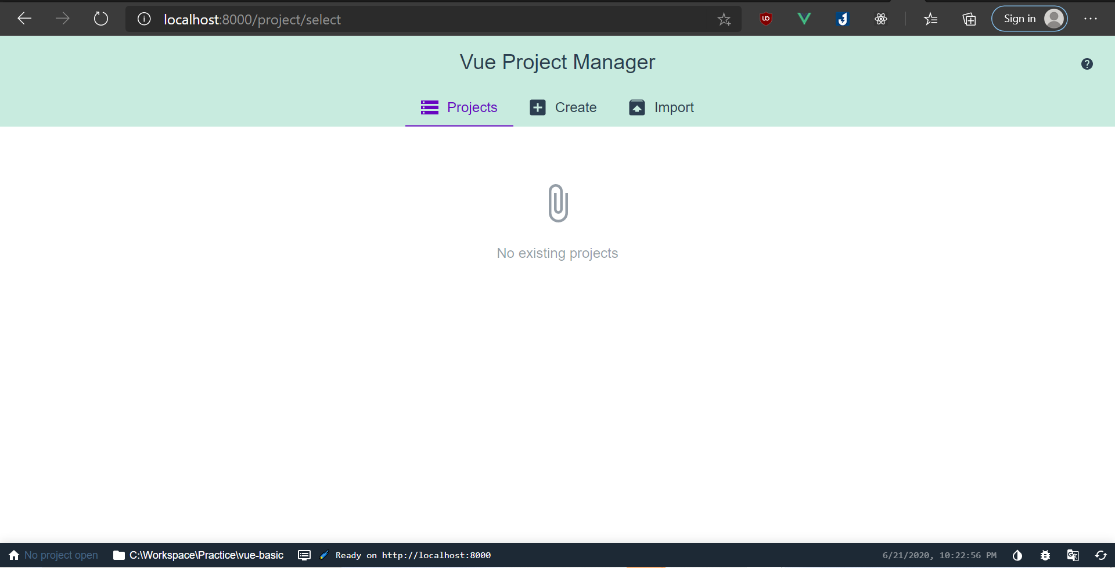
Vue CLI
CLI
CLI Service
CLI plugins
vue create <project_name>
vue serve
vue build
vue add
vue ui
Notes:
Vue also has it own build system – the vue-cli library.
These are the basic command of it

Slide 46
vue-loader and vue-template-compiler
vue-template-compiler: Compiles Vue template into render functions
vue-loader: A webpack loader which helps user author SFC
Notes:
I want to mention these library, because it’s mandatory to have when you use SFC.
These 2 library will help you build SFC to the working source code on browser

Slide 47


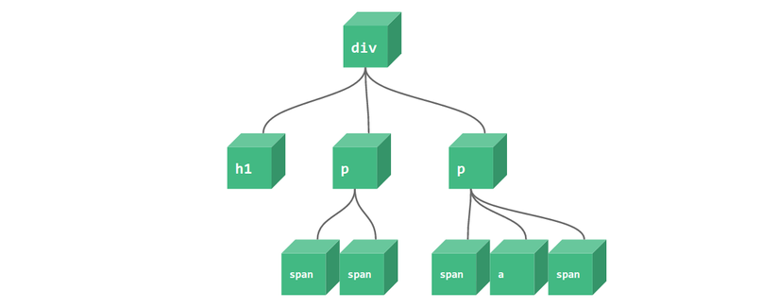
Vue rendering process
Vue Template
Render functions
VNodes
Real DOM
Virtual DOM
Pre-built
Notes:
- And this is a simple workflow showing how the Vue render its template on the browser
- The vue template will be compiled to render functions, then these render functions will generate the virtual DOM
- The virtual DOM is the where we actually interact in our code not the real DOM, the virtual will take care of manipulating the real DOM

Slide 48
Live coding

Slide 49
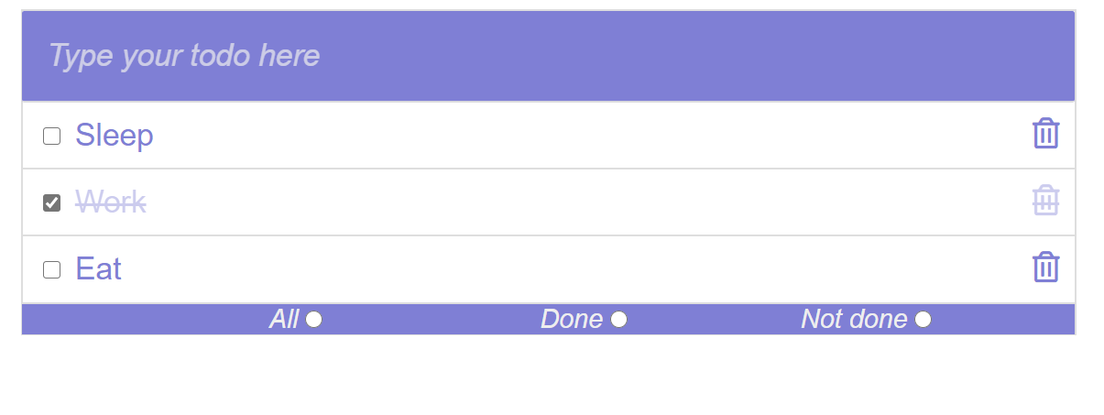
Todo app

Slide 50
Opinionated comparison

Slide 51
Compare with ReactJS
 | Vue | ReactJS
Reactive mechanism | Be specific on component | Use PureComponent to prevent re-render entire subtree components
Developing style | Easier for HTML-er | Easier for Javascript-er
Corporate libraries | Companion libraries like vue-router, vuex are officially supported by core team | React leaves these concern for community
Learning path | Easier for traditional web developer | Need to learn JSX and build systems

Slide 52
Comparison with Angular 2
 | Vue | Angular 2
Typescript based | No | Yes
Size | Smaller | Larger
Flexible | More | Less
Learning path | … | Steeper

Slide 53
Let’s “Vue” it! Thank you!

